Slide 1
SENG 405
Okay Yıldırım
Email: okay.yildirim@cankaya.edu.tr okay.yildirim@gmail.com
Android Development: Lecture Notes 2018 INFO 448 Mobile Development
University of Washington Information School https://info448.github.io/
Android App Development Winter 2019
Stanford University https://web.stanford.edu/class/cs193a/lectures.shtml
Youtube: https://www.youtube.com/channel/UCD6lt2Gz-GFH42gARDW0CPA
Android Developers
https://www.youtube.com/c/AndroidDevelopers
Notes:
https://developer.android.com

Slide 2
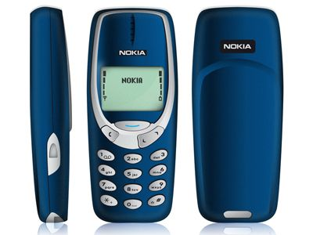

Slide 3
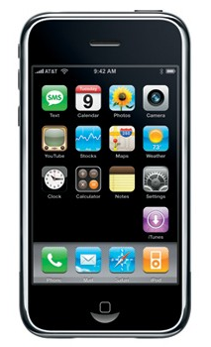
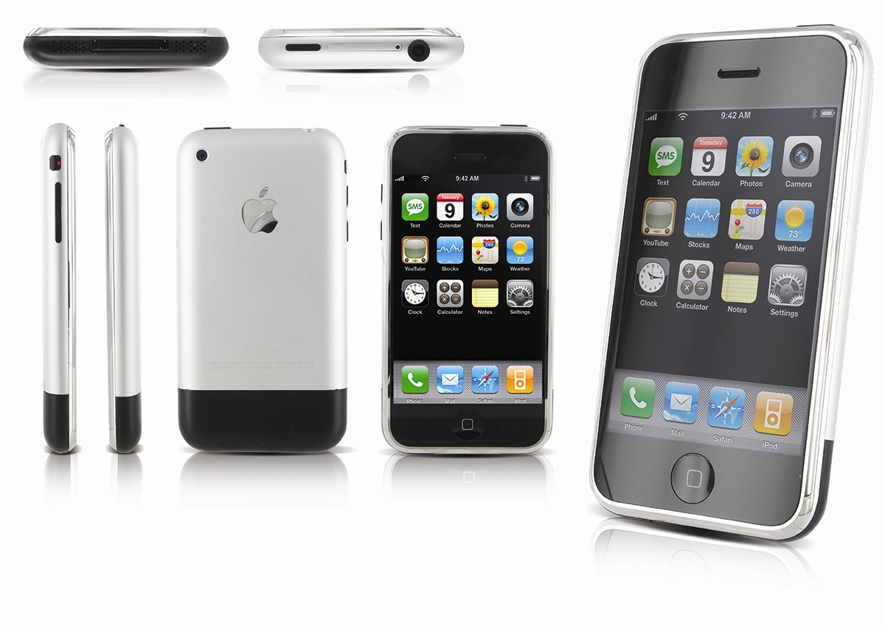
3.5 inch touch screen
320 x 480 pixel resolution
11.6mm thickness
2MP rear camera (No front camera, can't shoot video)
2G support
4, 8 and 16 GB storage options
iPhone OS (We later came to know as iOS)
1400mAh battery
412 MHz single core ARM 11 processor, PowerVR MBX graphics processor
Notes:
3.5 inch touch screen
320 x 480 pixel resolution
11.6mm thickness
2MP rear camera (No front camera, can't shoot video)
2G support
4, 8 and 16 GB storage options
iPhone OS (We later came to know as iOS)
1400mAh battery
412 MHz single core ARM 11 processor, PowerVR MBX graphics processor

Slide 4
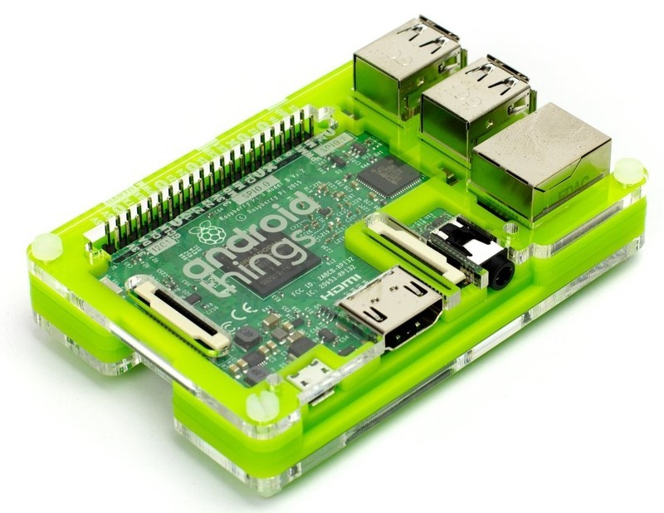
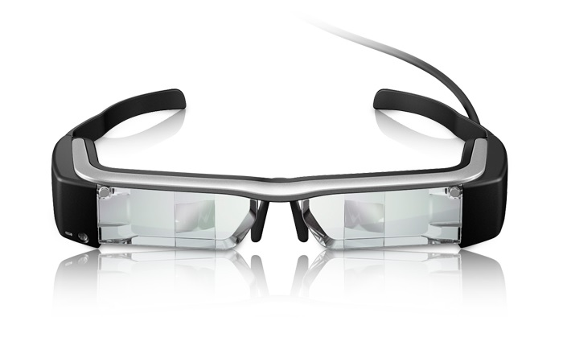
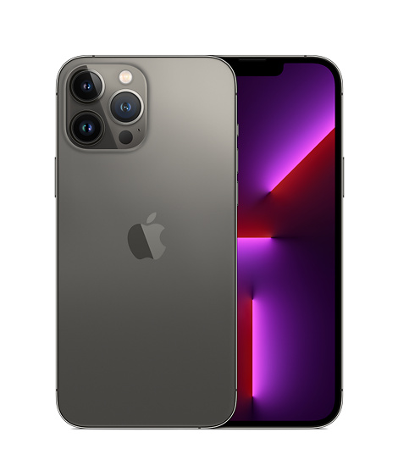
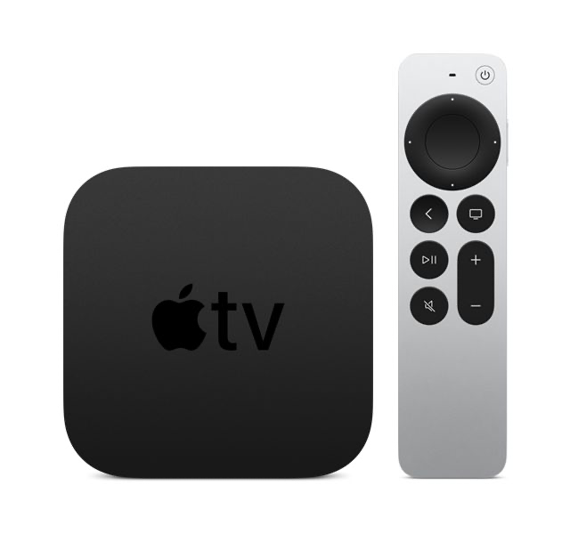
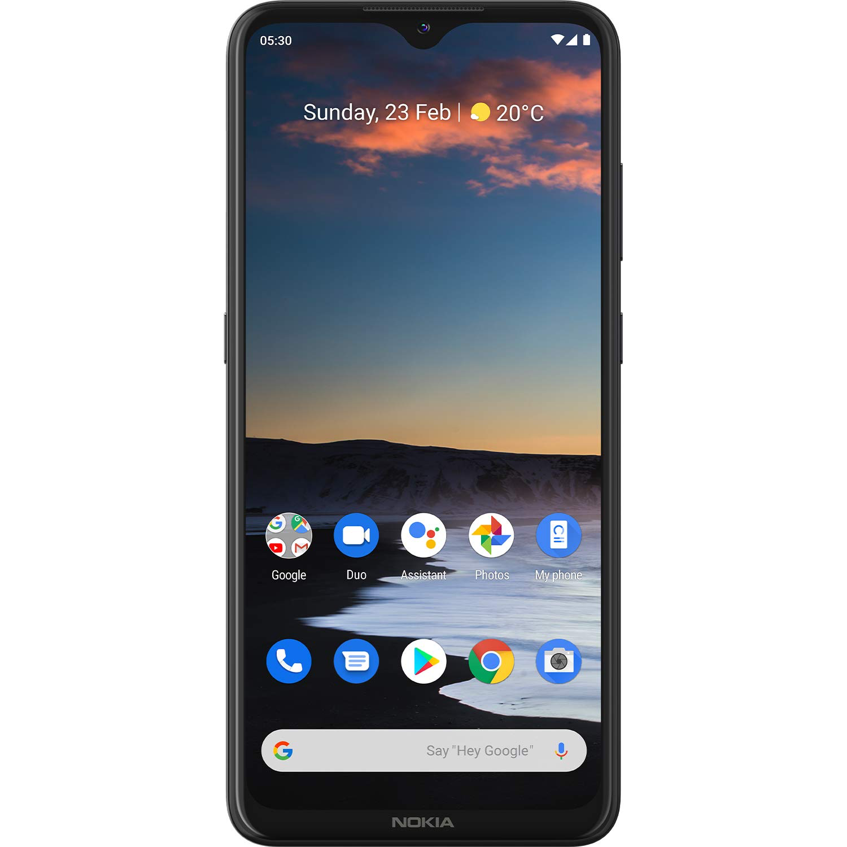
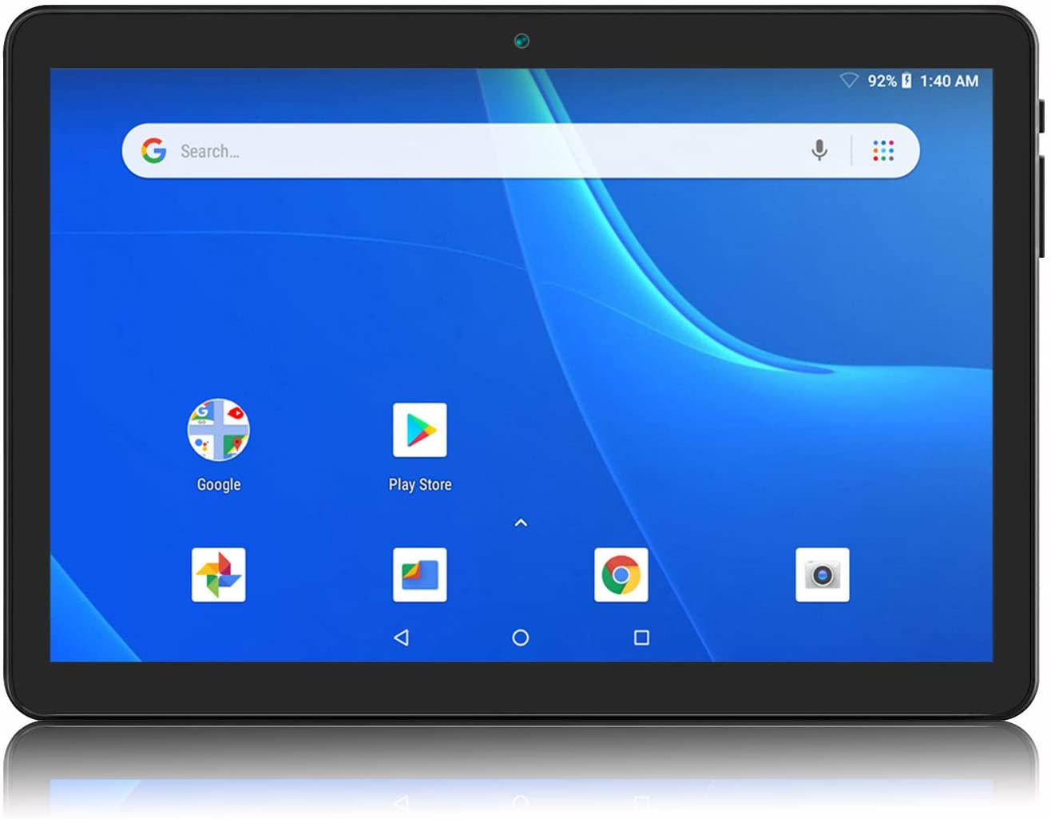
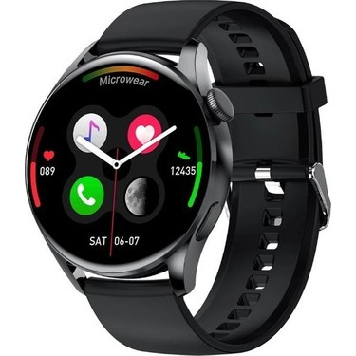
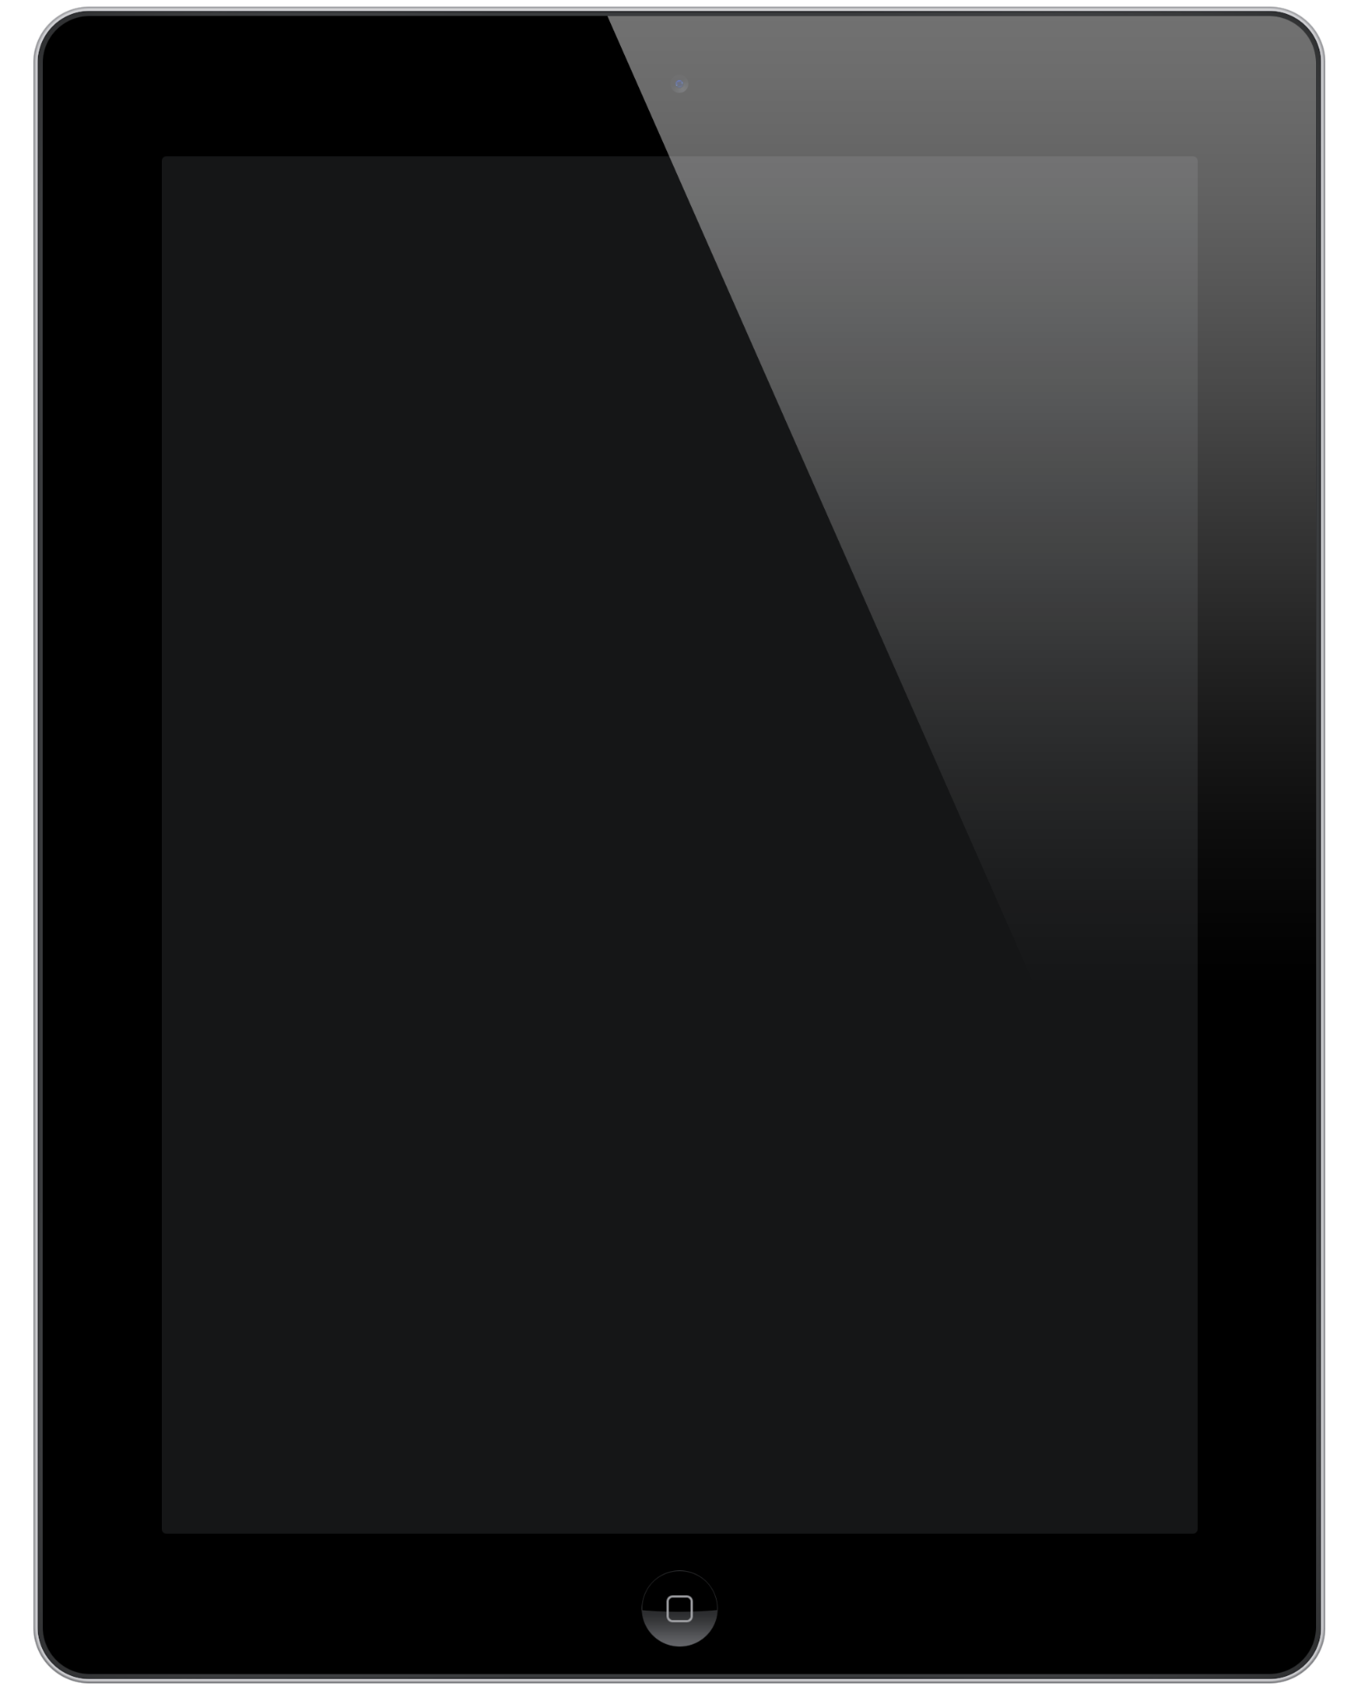
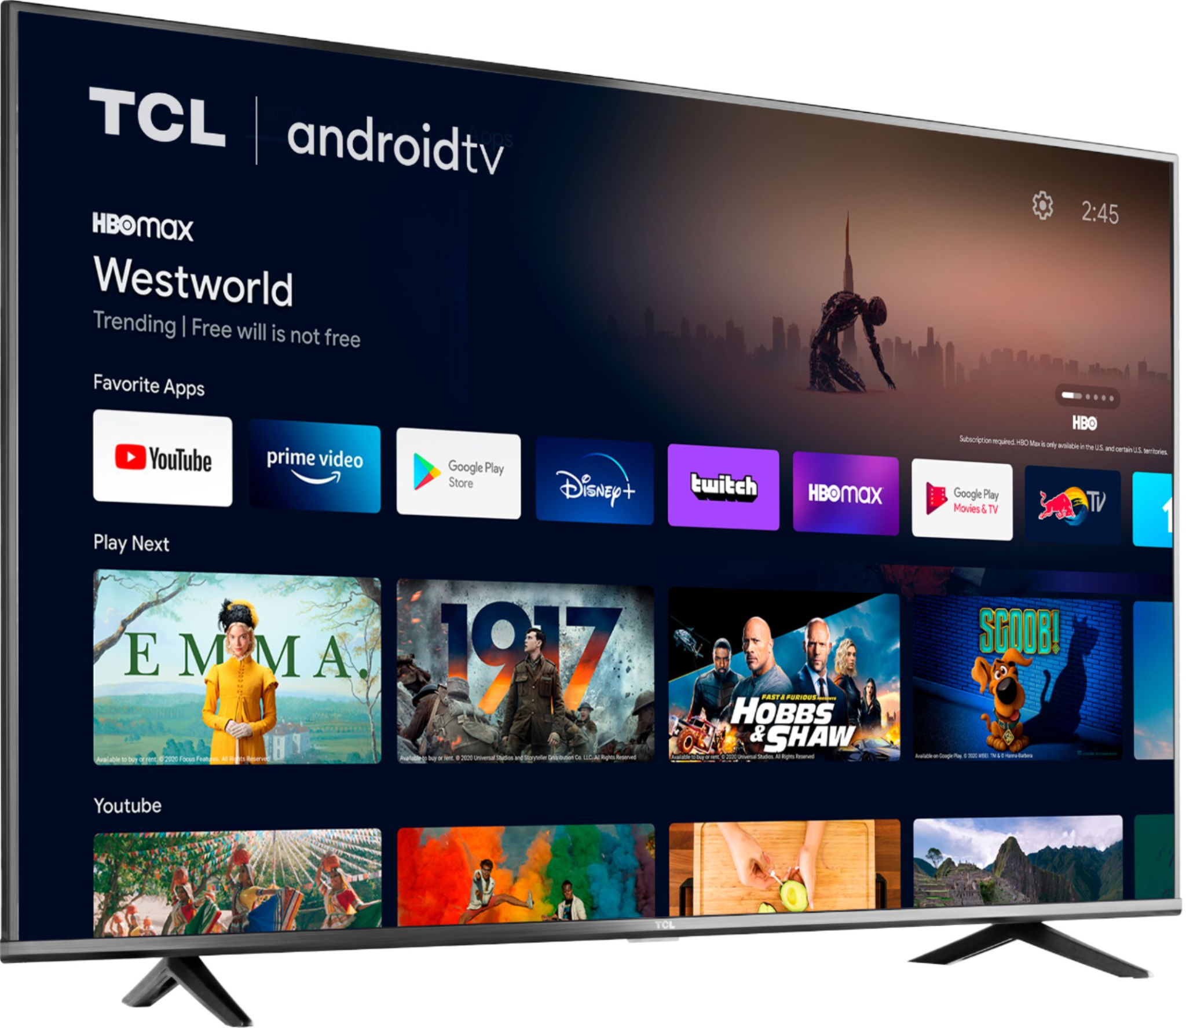
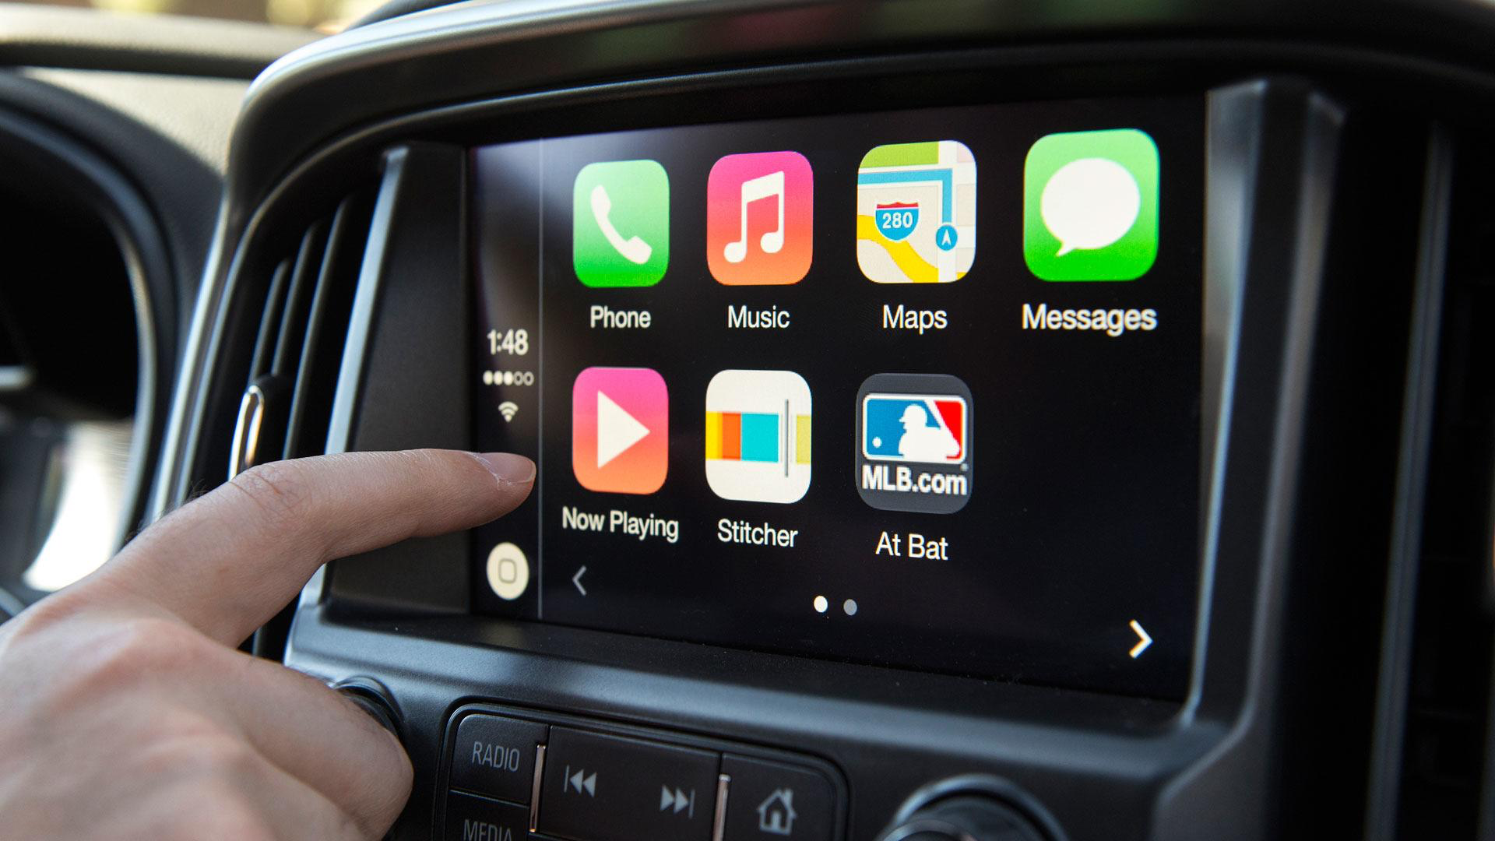
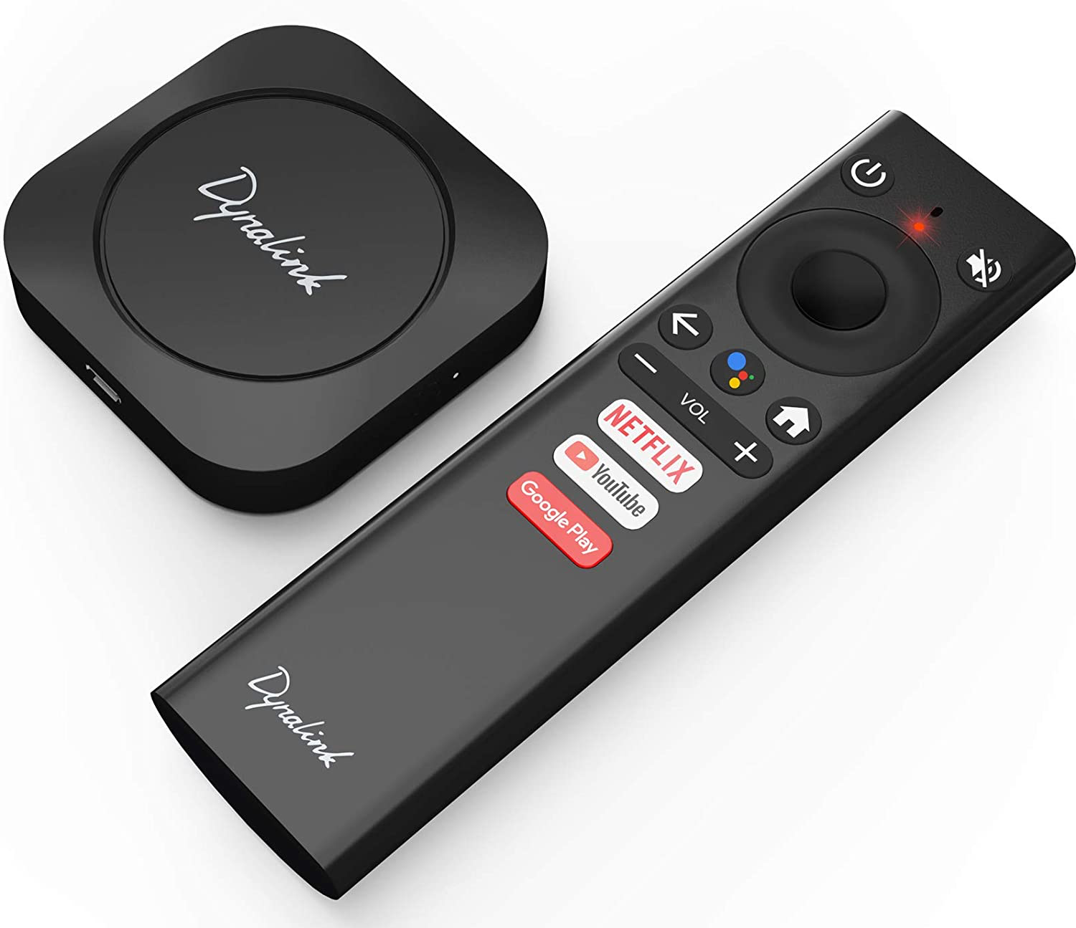
Mobile devices
Phone
TV
Car
Things

Slide 5

Why Mobile App?
User Experience!

Slide 6
Terminology
SOLID
Single-responsibility principle
Open–closed principle
Liskov substitution principle
Interface segregation principle
Dependency inversion principle
OOP
Abstraction
Encapsulation
Inheritance
Polymorphism
Firebase
JSON
Postman
Entity Model
Massive View Controller
SSL Pinning
Density
MVC

Slide 7
What is OOP
Abstraction
Encapsulation
Inheritance
Polymorphism

Slide 8
What is SOLID
Single Responsibility Principle
Open-Closed Principle
Liskov Substitution Principle
Interface Segregation Principle
Dependency Inversion Principle

Slide 9
Mobile Development Tech
Native
Android
Java
Kotlin
IOS
Swift
Objective - C
Hybrit
Flutter
React Native
Ionic
Xamarin

Slide 10
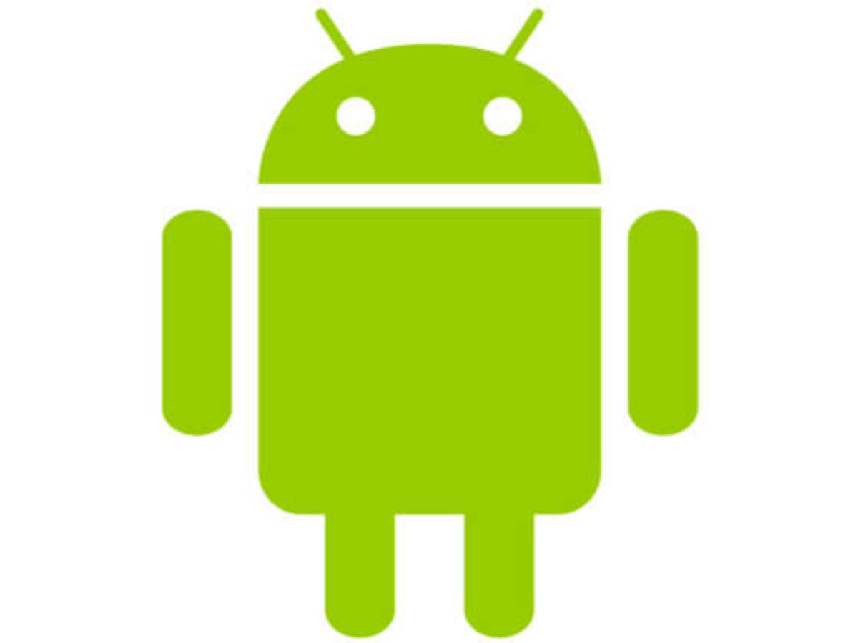

Slide 11
Why Android?
Easy development environment
Free Dev Tools (Apple $$)
Low Barier to submit app
Notes:
Deploy App to device Apple wants development certificate

Slide 12
Syllabus
I Lectures
Introduction (03.03.2024)
Resources and Layouts (10.03.2024)
Resources and Layouts - Practice (17.03.2024)
Activities (24.03.2024)
Activities - Practice (31.03.2024)
Networking (07.04.2024)
Networking - Practice (14.04.2024)
Data Driven Views (28.04.2024)
Data Driven Views - Practice (05.05.2024)
Local Data Source (12.05.2024)
Local Data Source - Practice (26.05.2024)
Fragments
Fragments - Practice

Slide 13
What is Android?
Android is a mobile operating system based on a modified version of the Linux kernel and other open source software, designed primarily for touchscreen mobile devices such as smartphones and tablets.
Notes:
Android is a mobile operating system based on a modified version of the Linux kernel and other open source software, designed primarily for touchscreen mobile devices such as smartphones and tablets.
That is, it’s software that connects hardware to software and provides general services. But more than that, it’s a mobile specific operating system: an OS designed to work on mobile (read: handheld, wearable, carry-able) devices.
Note that the term “Android” also is used to refer to the “platform” (e.g., devices that use the OS) as well as the ecosystem that surrounds it. This includes the device manufacturers who use the platform, and the applications that can be built and run on this platform. So “Android Development” technically means developing applications that run on the specific OS, it also gets generalized to refer to developing any kind of software that interacts with the platform.

Slide 14
1.1 Android History
2003: The platform was originally founded by a start-up “Android Inc.” which aimed to build a mobile OS operating system (similar to what Nokia’s Symbian was doing at the time)
2005: Android was acquired by Google, who was looking to get into mobile
2007: Google announces the Open Handset Alliance, a group of tech companies working together to develop “open standards” for mobile platforms. Members included phone manufacturers like HTC, Samsung, and Sony; mobile carriers like T-Mobile, Sprint, and NTT DoCoMo; hardware manufacturers like Broadcom and Nvidia; and others. The Open Handset Alliance now (2017) includes 86 companies.https://www.openhandsetalliance.com/ **Note this is the same year the first iPhone came out!
2008: First Android device is released: the HTC Dream (a.k.a. T-Mobile G1)
Specs: 528Mhz ARM chip; 256MB memory; 320x480 resolution capacitive touch; slide-out keyboard! Author’s opinion: a fun little device.
2010: First Nexus device is released: the Nexus One. These are Google-developed “flagship” devices, intended to show off the capabilities of the platform.
Specs: 1Ghz Scorpion; 512MB memory; .37" at 480x800 AMOLED capacitive touch. For comparison, the iPhone 8 Plus (2017) has: ~2.54Ghz hex-core A11 Bionic 64bit; 3GB RAM; 5.5" at 1920x1080 display.
(As of 2016, this program has been superseded by the Pixel range of devices).
2014: Android Wear, a version of Android for wearable devices (watches) is announced.
2016: Daydream, a virtual reality (VR) platform for Android is announced.

Slide 15
Android version History
Name | Internal codename | Version number(s) | Initial stable | Supported | API level
Android 1.0 | N/A | 1.0 | September 23, 2008 | No | 1
Android 1.1 | Petit Four | 1.1 | February 9, 2009 | No | 2
Android Cupcake | Cupcake | 1.5 | April 27, 2009 | No | 3
Android Donut | Donut | 1.6 | September 15, 2009 | No | 4
Android Eclair | Eclair | 2.0 | October 27, 2009 | No | 5
 |  | 2.0.1 | December 3, 2009 | No | 6
 |  | 2.1 | January 11, 2010 | No | 7
Android Froyo | Froyo | 2.2 – 2.2.3 | May 20, 2010 | No | 8
Android Gingerbread | Gingerbread | 2.3 – 2.3.2 | December 6, 2010 | No | 9
 |  | 2.3.3 – 2.3.7 | February 9, 2011 | No | 10

Slide 16
Android version History
Name | Internal codename | Version number(s) | Initial stable | Supported | API level
Android Honeycomb | Honeycomb | 3.0 | February 22, 2011 | No | 11
 |  | 3.1 | May 10, 2011 | No | 12
 |  | 3.2 – 3.2.6 | July 15, 2011 | No | 13
Android Ice Cream Sandwich | Ice Cream Sandwich | 4.0 – 4.0.2 | October 18, 2011 | No | 14
 |  | 4.0.3 – 4.0.4 | December 16, 2011 | No | 15
Android Jelly Bean | Jelly Bean | 4.1 – 4.1.2 | July 9, 2012 | No | 16
 |  | 4.2 – 4.2.2 | November 13, 2012 | No | 17
 |  | 4.3 – 4.3.1 | July 24, 2013 | No | 18
Android KitKat | Key Lime Pie | 4.4 – 4.4.4 | October 31, 2013 | No | 19
 |  | 4.4W – 4.4W.2 | June 25, 2014 | No | 20

Slide 17
Android version History
Name | Internal codename | Version number(s) | Initial stable | Supported | API level
Android Lollipop | Lemon Meringue Pie | 5.0 – 5.0.2 | November 4, 2014 | No | 21
 |  | 5.1 – 5.1.1 | March 2, 2015 | No | 22
Android Marshmallow | Macadamia Nut Cookie | 6.0 – 6.0.1 | October 2, 2015 | No | 23
Android Nougat | New York Cheesecake | 7.0 | August 22, 2016 | No | 24
 |  | 7.1 – 7.1.2 | October 4, 2016 | No | 25
Android Oreo | Oatmeal Cookie | 8.0 | August 21, 2017 | No | 26
 |  | 8.1 | December 5, 2017 | No | 27

Slide 18
Android version History
Name | Internal codename | Version number(s) | Initial stable | Supported | API level
Android Pie | Pistachio Ice Cream | 9 | August 6, 2018 | Yes | 28
Android 10 | Quince Tart | 10 | September 3, 2019 | Yes | 29
Android 11 | Red Velvet Cake | 11 | September 8, 2020 | Yes | 30
Android 12 | Snow Cone | 12 | October 4, 2021 | Yes | 31
Android 12L | Snow Cone v2 | TBA | Q1 2022 | Presupported | 32
Android 13 | Tiramisu | 13 | Q3 2022 | Presupported | 33

Slide 19
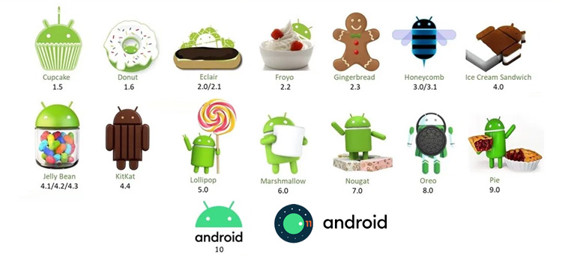
Android Versions

Slide 20
Deeper
https://developer.android.com/about/versions
https://developer.android.com/about/dashboards/
https://source.android.com/setup/build/downloading
https://developer.android.com/studio/command-line/index.html
https://github.com/orgs/android/repositories
https://developer.android.com/topic/architecture

Slide 21
Legal Battles
Oracle vs Google
Oracle claims that the Java API is copyrighted (that the method signatures themselves and how they work are protected), so because Google uses that API in Android, Google is violating the copyright.
In 2012 a California federal judge decided in Google favor (that one can’t copyright an API).
This was then reversed by the Federal Circuit court in 2014.
The verdict was appealed to the US Supreme Court in 2015, who refused to hear the case.
It then went back to the the district court, which ruled in 2016 that Google’s use of the API was fair use.
https://www.eff.org/cases/oracle-v-google
https://arstechnica.com/series/series-oracle-v-google/
Notes:
One interesting side effect of this battle: the Android Nougat and later uses the OpenJDK implementation of Java, instead of Google’s own in-violation-but-fair-use implementation see here. This change shouldn’t have any impact on you as a developer, but it’s worth keeping an eye out for potentially differences between Android and Java SE. This may also be a motivator for Android to make Kotlin its primary language.
There have been other legal challenges as well. While not directly about Android, the other major relevant court battle is Apple v Samsung. In this case, Apple claims that Samsung infringed on their intellectual property (their design patents). This has gone back and forth in terms of damages and what is considered infringing; as of this writing, the latest development is that the Supreme Court heard the case and sided with Samsung that infringing design patents shouldn’t lead to damages in terms of the entire device… it’s complicated (the author is not a lawyer).
So overall: Android is a growing, evolving platform that is embedded in and affecting the social infrastructures around information technology in numerous ways.

Slide 22
What Do You Need?
Programming Skill
Problem Solve Skill
Additional Tools
Postman
https://www.jsonschema2pojo.org/ for pojo (plain old Java object) or https://app.quicktype.io/

Slide 23
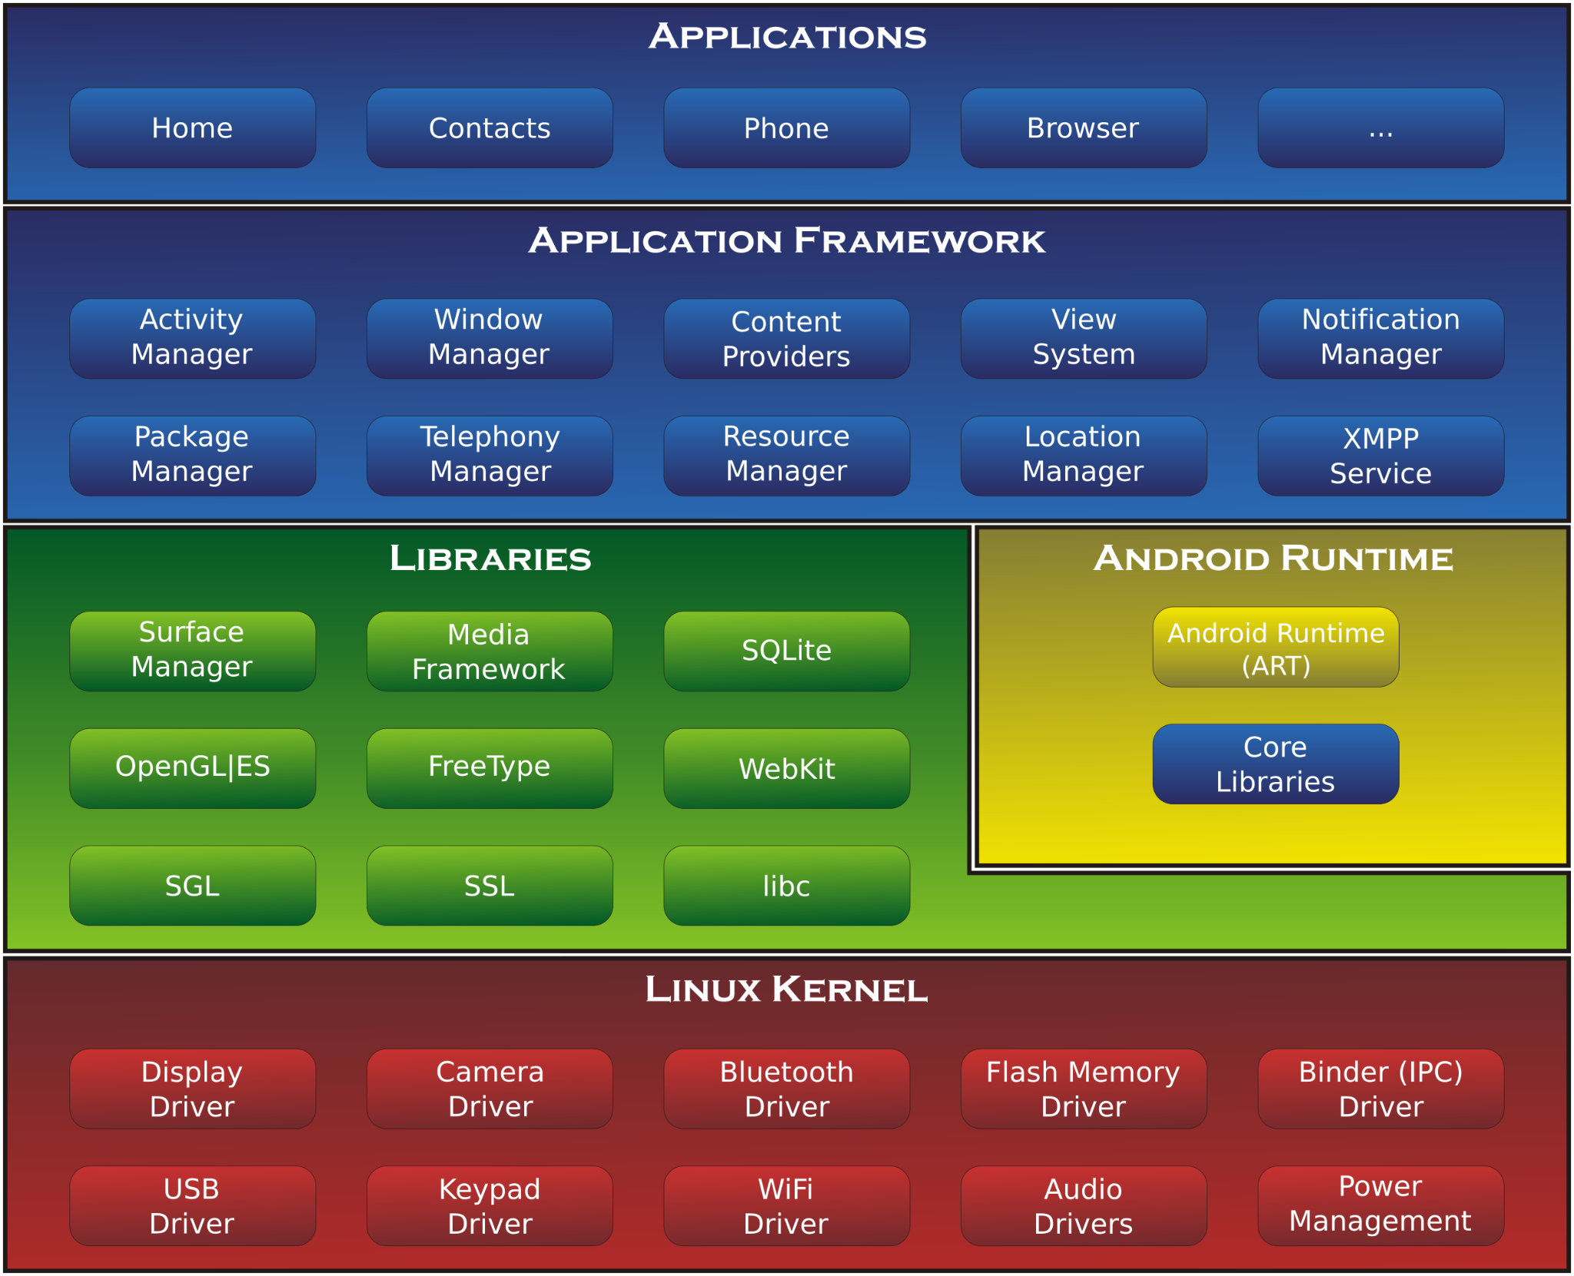
Android Architecture
Linux kernel
Libraries
Android Runtime
Application Framework
Application
Notes:
1.Linux kernel – Linux kernel is the bottom layer of android architecture. This layer provides a basic system functionality like process management, device management like Camera, Keypad, Display, Bluetooth and all the drivers of system .
2.Libraries – At the top of linux kernel layer next layer is known as libraries. In this layer all the libraries like open-source Web browser engine webkit, well known libc, media framework, SGL, Free Type, SQLite database for storage and sharing of application data, libraries to play and record audio and video, SSL libraries responsible for internet security etc.
Surface Manager: It is used for compositing window manager with off-screen buffering. Off-screen buffering means the apps can’t directly draw into the screen, instead the drawings go to the off-screen buffer. There it is combined with other drawings and form the final screen the user will see. This off screen buffer is the reason behind the transparency of windows.
android.app – Provides access to the application model and is the cornerstone of all Android applications.
android.content – Facilitates content access, publishing and messaging between applications and application components.
android.database – Used to access data published by content providers and includes SQLite database management classes.
android.graphics – A low-level 2D graphics drawing API including colors, points, filters, rectangles and canvases.
android.hardware – Presents an API providing access to hardware such as the accelerometer and light sensor.
android.opengl – A Java interface to the OpenGL ES 3D graphics rendering API.
android.os – Provides applications with access to standard operating system services including messages, system services and inter-process communication.
android.media – Provides classes to enable playback of audio and video.
android.net – A set of APIs providing access to the network stack. Includes android.net.wifi, which provides access to the device’s wireless stack.
android.provider – A set of convenience classes that provide access to standard Android content provider databases such as those maintained by the calendar and contact applications.
android.text – Used to render and manipulate text on a device display.
android.util – A set of utility classes for performing tasks such as string and number conversion, XML handling and date and time manipulation.
android.view – The fundamental building blocks of application user interfaces.
android.widget – A rich collection of pre-built user interface components such as buttons, labels, list views, layout managers, radio buttons etc.
android.webkit – A set of classes intended to allow web-browsing capabilities to be built into applications.
3. Andorid runtime – In Android Architecture this is a third section that is available on the second layer from the bottom. This section provide a key component called Dalvik Virtual Machine just like a java virtual machine (JVM) but it is specially designed and optimized for Android.
Every Android application runs in its own process, with its own instance of the Dalvik virtual machine. Dalvik has been written so that a device can run multiple VMs efficiently.
The Dalvik VM executes files in the Dalvik Executable (.dex) format which is optimised for minimal memory footprint.
The VM is register-based, and runs classes compiled by a Java language compiler that have been transformed into the .dex format by the included “dx” tool.
4.Application Framework – Application Framework layer provides many higher-level services to application in the form of java classes. Our applications directly interact with these blocks of the Android architecture.
The Android Framework includes the following key services:-
Activity Manager – Controls all aspects of the application lifecycle and activity stack.
Content Providers – Allows applications to publish and share data with other applications.
Resource Manager – Provides access to non-code embedded resources such as strings, color settings and user interface layouts.
Notifications Manager – Allows applications to display alerts and notifications to the user.
View System – An extensible set of views used to create application user interfaces.
Package Manager – The system by which applications are able to find out information about other applications currently installed on the device.
Telephony Manager – Provides information to the application about the telephony services available on the device such as status and subscriber information.
Location Manager – Provides access to the location services allowing an application to receive updates about location changes.
5.Applications – You will find all the Android application at the top layer. You will write your application to be installed on the layer only. Example of such application are Contacts, Books, Browser, Games, or any other application you installed in your device.

Slide 24
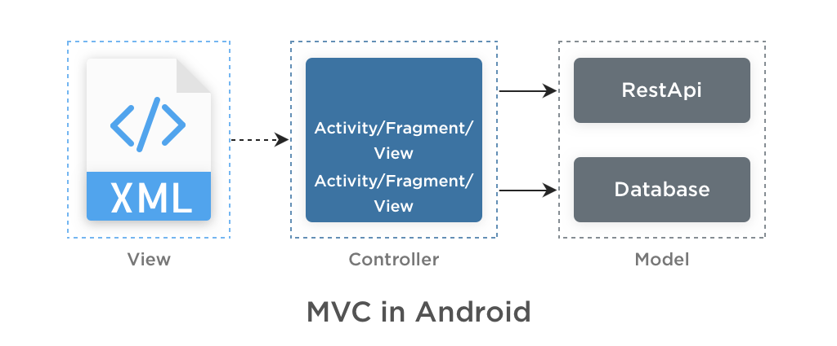
Android MVC

